Slide 1
LEARN Style Inventory

Slide 2
Hero
Home, Get Coverage, Change or Update Plan

Slide 3


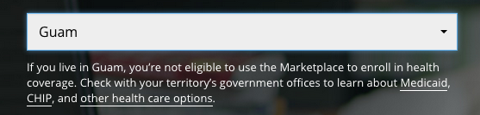
H1 – Open Sans 60px #FFF font-weight 400, letter-spacing -2, line-height 67px
Subhead – Open Sans 18px, letter-spacing 0, line-height 25px
Below Primary CTA – Open Sans 13px #FFF, letter-spacing 0, line-height 18px
Multiline Below Primary CTA – div 500px

Slide 4
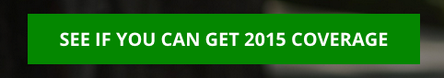
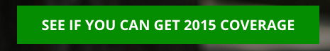
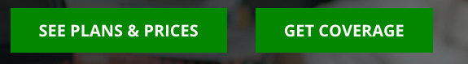
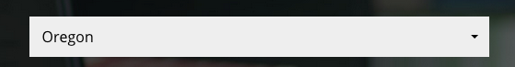
Button Default – Open Sans 20px Bold #FFF, background #12890e, padding 35px,
Button Rollover – Open Sans 20px Bold #FFF, background #138F0E, padding 35px
Dual CTA – 35px between
Dropdown – Open Sans 1.5em #555, dropdown height 44px, background #EEE

Slide 5
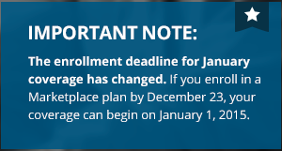
Alerts – Open Sans 13px Regular #FFF, (blue) background #055072, (red) #b91e1f
Secondary Alert – Open Sans 21px Bold & 13px #FFF, background #0C567B

Slide 6
Hero
Get Answers

Slide 7
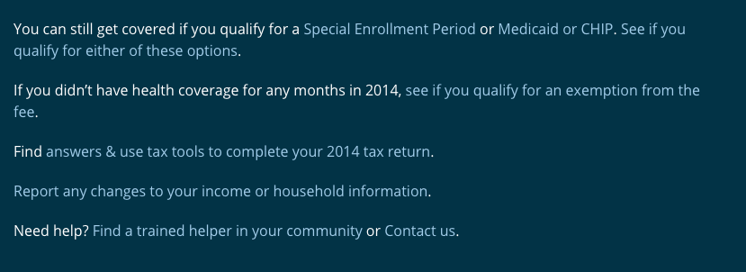
H1 – Bitter 36px #FFF font-weight 400, letter-spacing normal, line-height 44px
Paragraph – Open Sans 16px #FFF, line-height 24px
Links #A3CCE8 – Rollover #CFEFFE

Slide 8

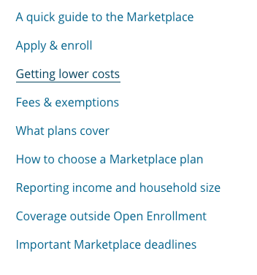
H2 – Bitter 35px #333 font-weight 400, letter-spacing normal, line-height 32px
H3 – Bitter 21px #666 font-weight 400, letter-spacing normal, line-height 25px
Border-bottom – 1px #CCC
List – Open Sans 16px #0C648C font-weight 400, text decoration underline, line-height 24px

Slide 9
Secondary CTA

Slide 10



Glyphicon – 34px #FFF, font-weight 400, background-color #043F59
Title – Open Sans 26px #FFF, font-weight: bold, letter-spacing -1px
Button Default – Open Sans 20px Bold #FFF, background #12890e, padding 35px,
Button Rollover – Open Sans 20px Bold #FFF, background #138F0E, padding 35px,

Slide 11
Action Bar

Slide 12
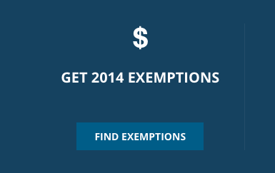
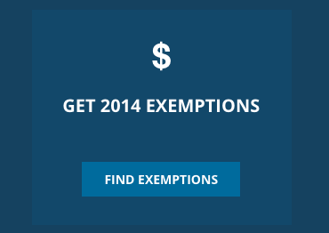



Tile Default – Background #17415F
Tile Rollover – Background #164769
Text – Open Sans 20px Bold #FFF
Glyphicon – 30px #FFF
Button Default – Open Sans 1.5em #FFF, Background #0A5C87, Rollover Background #0C6A9C

Slide 13
Subscribe Module

Slide 14



H2 – Open Sans 20px Bold #FFF
Descriptor text – Open Sans 13px #FFF, line-height 17px
Form field default – Height 38px, background #EEE
Button – Open Sans 16px Bold #FFF, Background #063346
Button rollover – Background #1295e8
Form field text – Open Sans 16px #555
Footnote – Open Sans 10px #FFF, link 1px underline

Slide 15
Blog Module

Slide 16




H2 – Open Sans 20px Bold #FFF, Rollover underline
Glyphicon – 20px Bold #FFF
Date – Open Sans 13px Bold #FFF, line-height 17px, border-bottom 2px Solid #39C
Title – Open Sans 13px Regular #FFF, line-height 17px, Rollover underline
Button Default – Height 38px, background #EEE
Button – Open Sans 16px Bold #FFF, Background #063346
Button rollover – Background #1295e8

Slide 17
Explainer

Slide 18

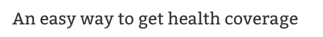
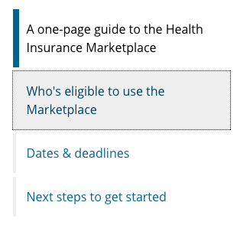
H1 – Bitter 36px Font-weight 400 #333, line-height 44px, letter-spacing normal
H1 – Bitter 22px Font-weight 400 #666, line-height 24px
Nav Tabs – Open Sans 16px Font-weight 400 #000, link #0C648C, background #eee, underline line-height 24px

Slide 19
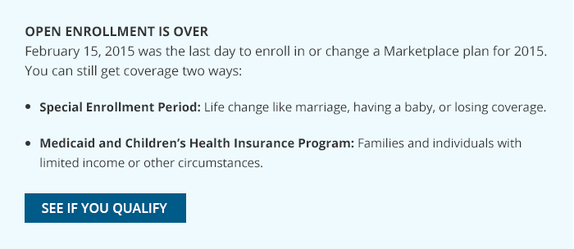
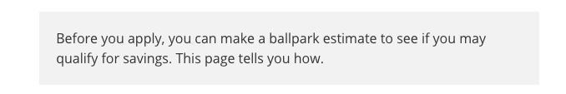
Notification Box - Background #EEFAFE
H2 – Open Sans 16px Bold #333, letter-spacing normal, line-height 32px
P – Open Sans 16px #333, line-height 24px
List – Open Sans 15px #333, link #0C648C
Button – Open Sans 16px Bold #FFF, Background #0A5c87, Rollover #0C6A9C
Block quote - Background #F2F2F2
Open Sans 16px Bold #333, line-height 24px, link #0C648C

Slide 20
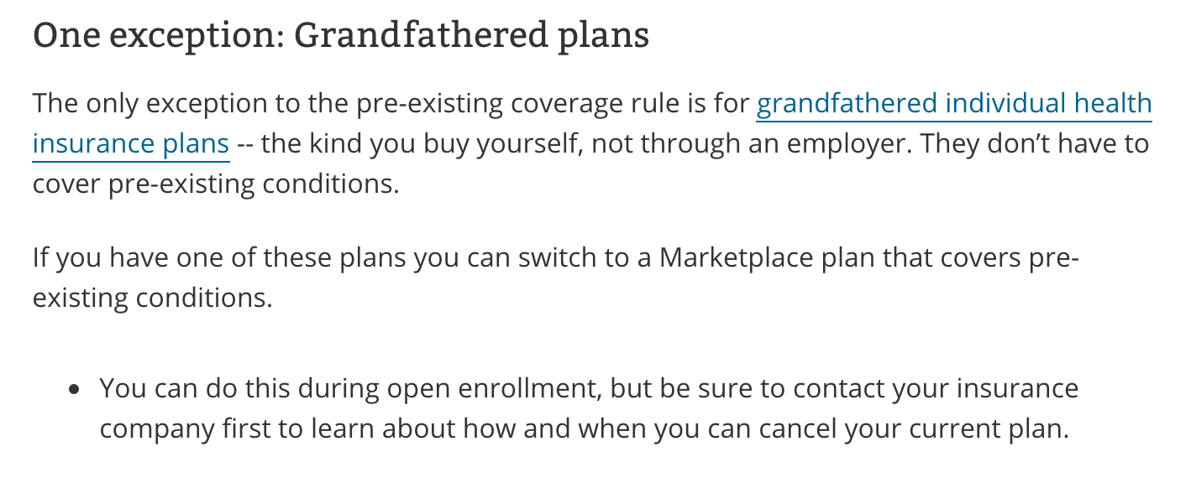
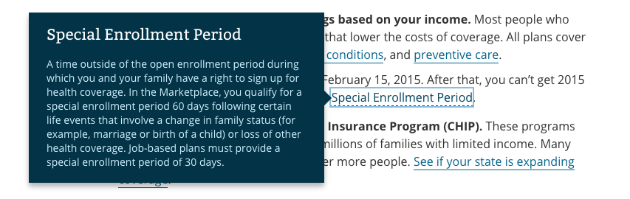
H3 – Bitter 21px font-weight normal #333, letter-spacing normal, line-height 25px
P – Open Sans 16px #333, link #0C648C, border-bottom 1px #0C648C, line-height 24px
Glossary-term – border-bottom dashed
Tooltip
Title – Bitter 21px #FFF font-weight normal
Text – Open Sans 14px #CDEDFA font-weight normal, line-spacing 19px

Slide 21
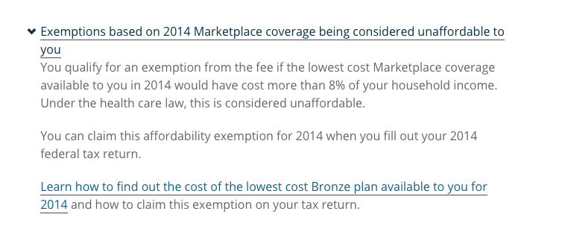
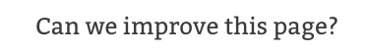
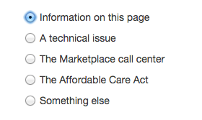
FAQ Question – Open Sans 16px font-weight normal #063346, letter-spacing normal, line-height 24px, border-bottom 1px #08425D
FAQ Question .answer – Open Sans 16px #666, line-height 24px
Survey H2 – Bitter 24px, line-height 32px
Questions – Helvetica Neue 14px #3B3B3B

Slide 22
Article

Slide 23
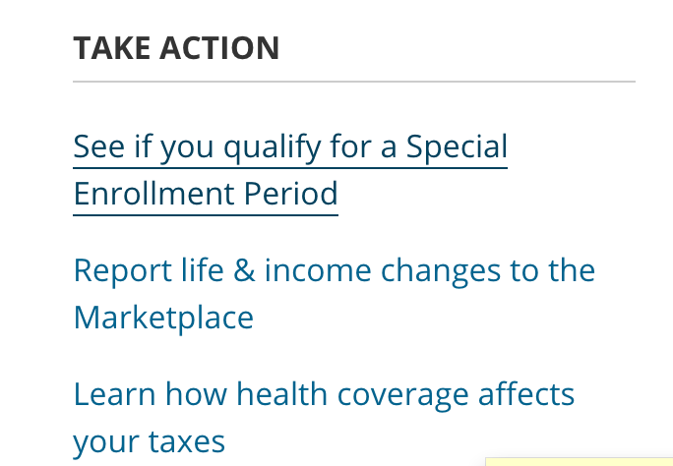
Take Action
H4 – Open Sans 16px Bold#333, line-height 24px
List – Open Sans 16px normal, links #0C648C, Rollover underline
Content styling same as Explainer pages

Slide 24
Blog

Slide 25


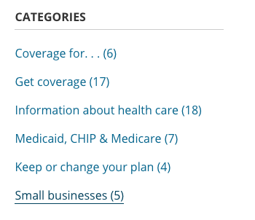
H1 – Bitter 36px font-weight 400 #333, letter-spacing normal, line-height 44px
H2 – Bitter 24px font-weight 400 #0C648C, letter-spacing normal, line-height 32px
Date – Open Sans 14px #666, line-height 24px
H4 – Open Sans 16px Bold#333, line-height 24px
List – Open Sans 16px normal, links #0C648C, Rollover underline

Slide 26

Button – Open Sans 16px font-weight 700 #0E70B4, Background #EEE, rollover #0E70B4
Content styling same as Explainer pages

Slide 27
Sitemap

Slide 28



H1 – Bitter 36px font-weight 400 #333, letter-spacing normal, line-height 44px
H2 – Bitter 24px font-weight 400 #0C648C, Rollover #08425d
H3 – Open Sans 16px font-weight 700 #333, Text-transform uppercase
List – Open Sans 1.5em font-weight 400 #0C648C, Rollover 1px #08425d

Slide 29
Glossary

Slide 30

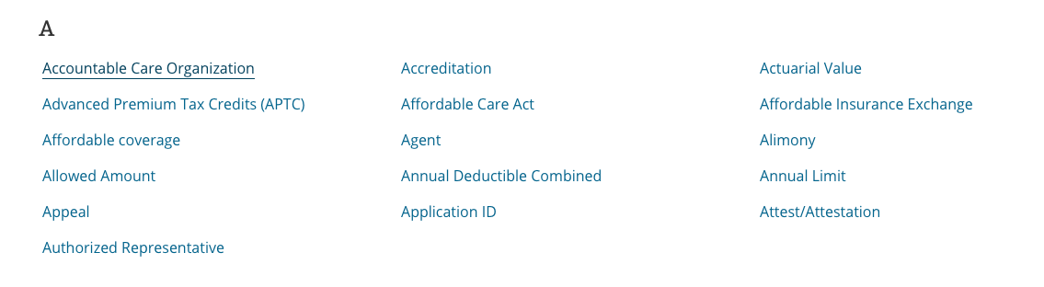
H1 – Bitter 36px font-weight 400 #333, letter-spacing normal, line-height 44px
Nav – Open Sans 16px font-weight Bold #0C648C, Rollover #000000, Background #EEE
Links
H2 – Bitter 24px font-weight 400 #333,
List – Open Sans 16px #0C648C, rollover #08425d underline, line-height 24px,

Slide 31
Modal

Slide 32
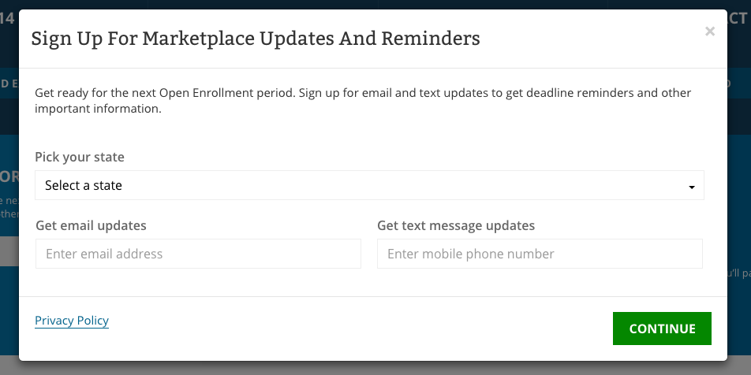

Slide 33

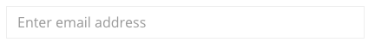

H1 – Bitter 24px font-weight 400 #333, letter-spacing normal, line-height 44px
Text – Open Sans 1.5em font-weight 400 #333, line-height 24px
Form Label – Open Sans 16px font-weight 600 #666, line-height 24px
Form Field – Open Sans 1.5em font-weight normal #000, Border-color #EEE
Button – Open Sans 16px font-weight 700 #FFF, Background #12890E, Rollover #0F720C
Privacy Link – Open Sans 1.5em #0C648C, border-bottom 1px #0F720C

Slide 34
Contact Us

Slide 35
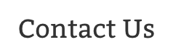

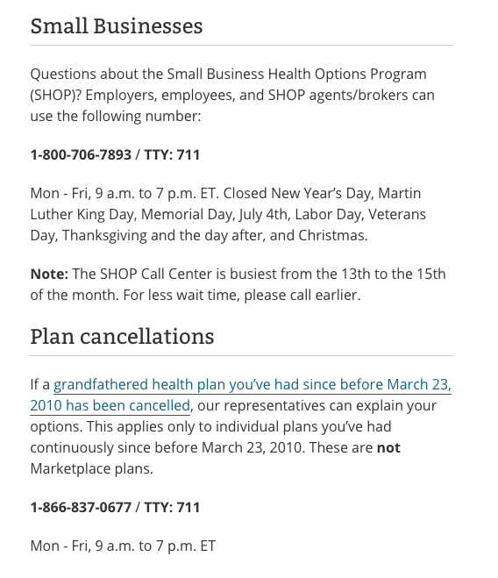
H1 – Bitter 36px font-weight 400 #333, letter-spacing normal, line-height 44px
H2 – Bitter 24px font-weight 400 #333, letter-spacing normal, line-height 32px
Content – Same as Explainer / 2 column template

Slide 36
SHOP

Slide 37

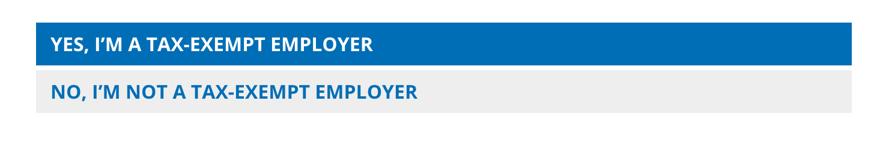
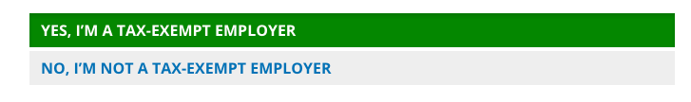
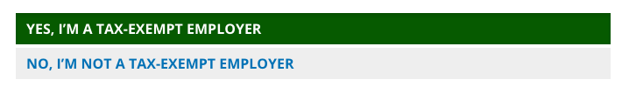
H1 – Bitter 36px font-weight 400 #333, letter-spacing normal, line-height 44px
Label – Open Sans 21px font-weight 400 #666, line-height 40px
Radio – Open Sans 21px font-weight 400 #666, line-height 40px
Default background #eeeeee, Rollover #0e70b4, Selected #12890e, Selected rollover #0c5b09

Slide 38
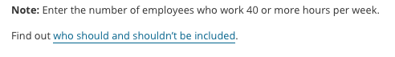
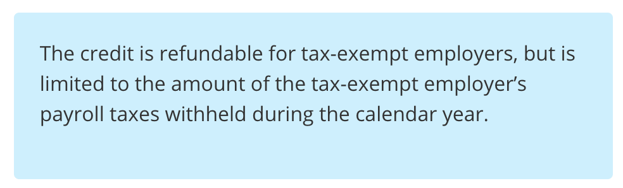



Form field – Open Sans 16px font-weight 400 #555, Background #EEE
Help text– Open Sans 80% font-weight 400 #333, link #0C648C, border-bottom 1px #0C648C, Background #EEE, line-height 250%
Instructions– Open Sans 16px #333, line-height 24px, Background #CFEFFC,
Buttons– Open Sans 21px font-weight 700 #FFF, line-height 24px
Default Blue #0E70B4, Rollover #0c619c, Default Green #12890E, Rollover #0f720c

Slide 39
Templates

Slide 40
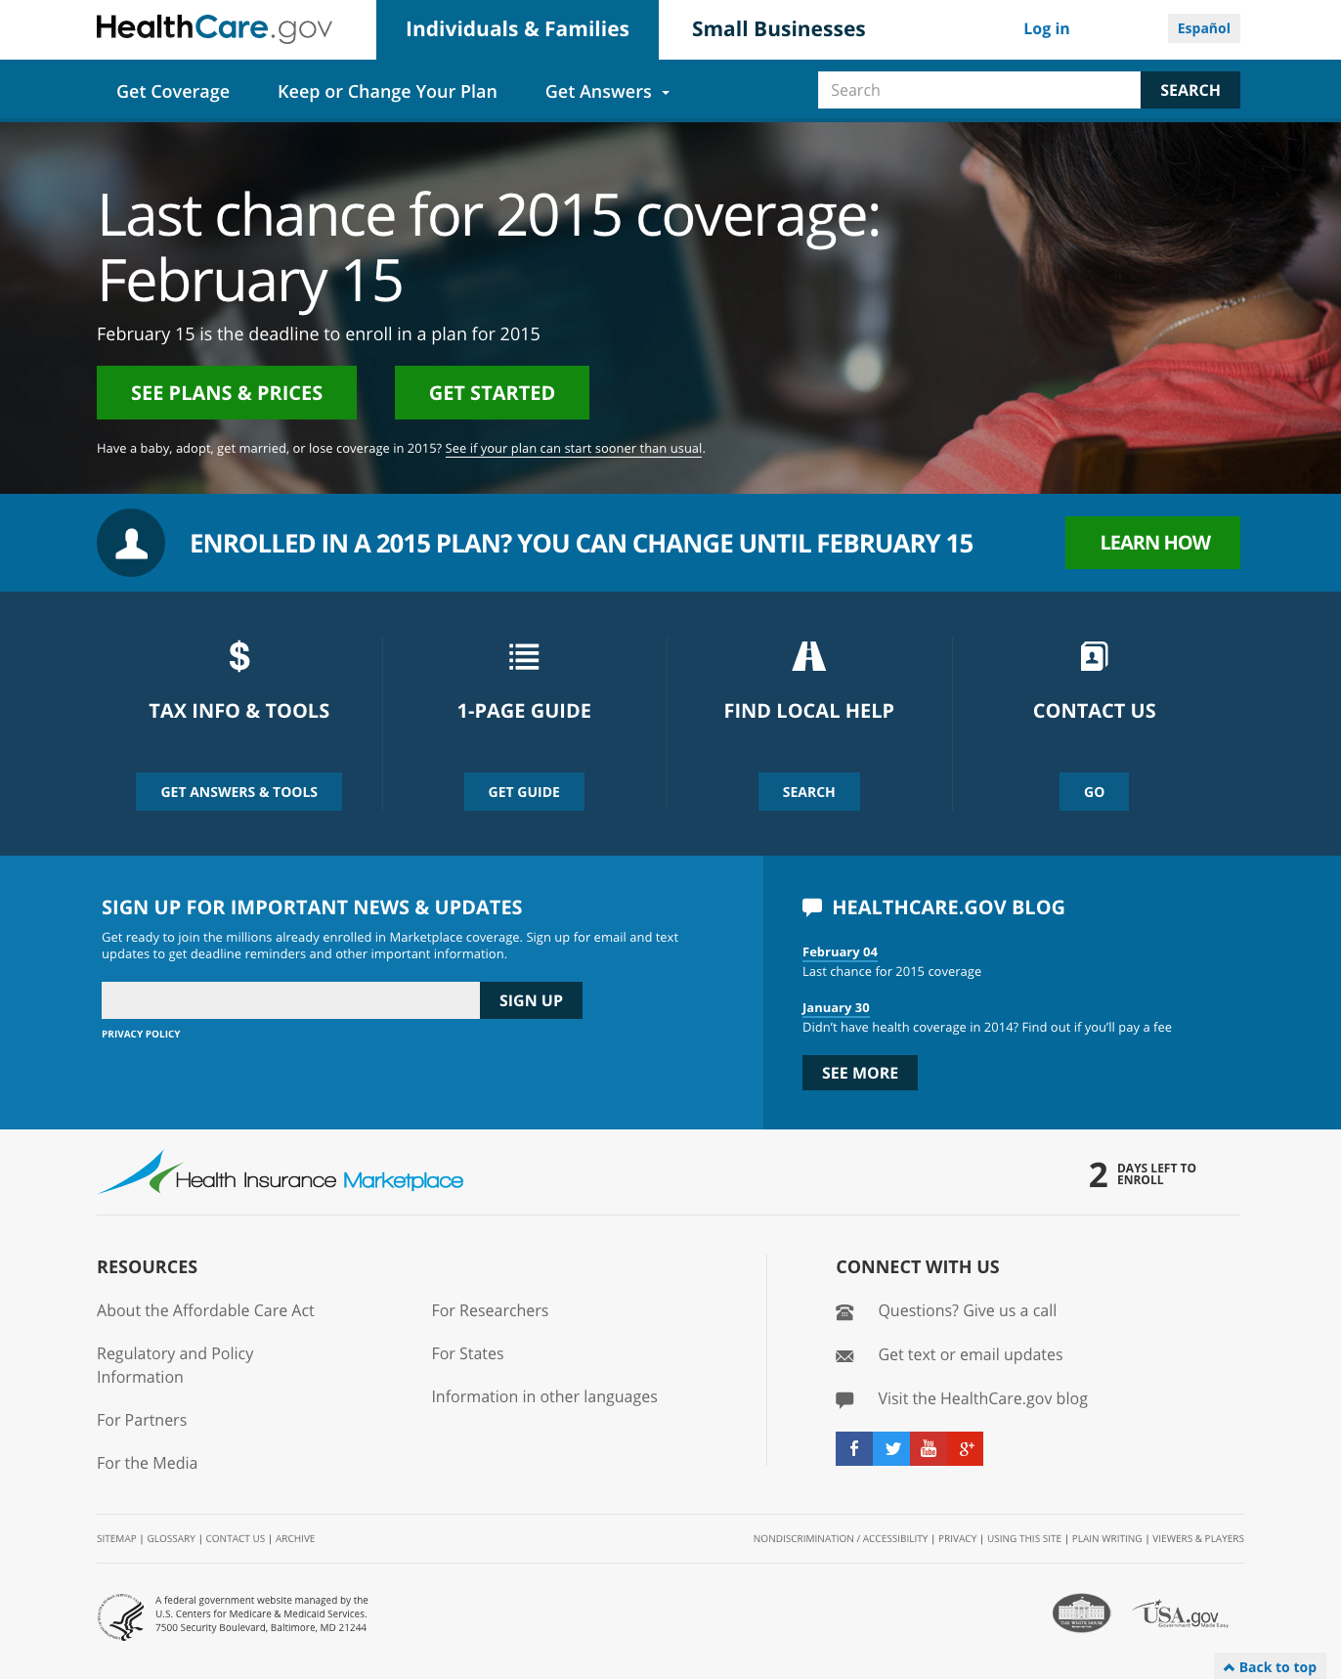
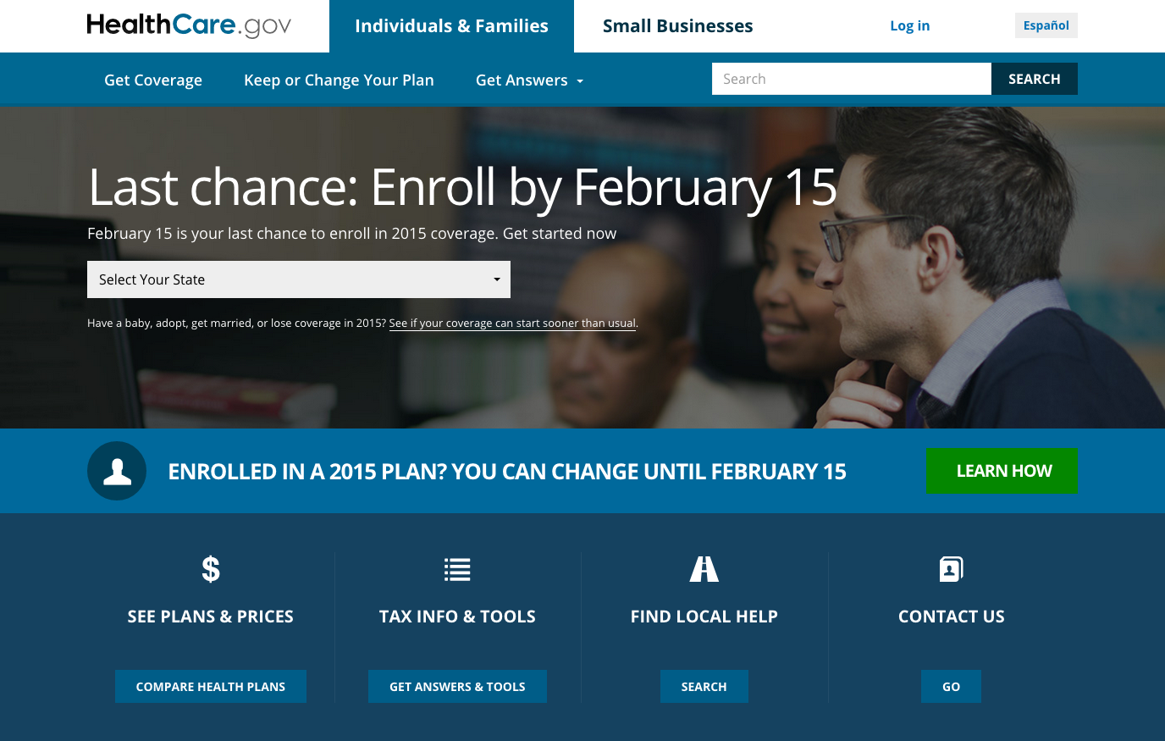
Home
Landing

Slide 41
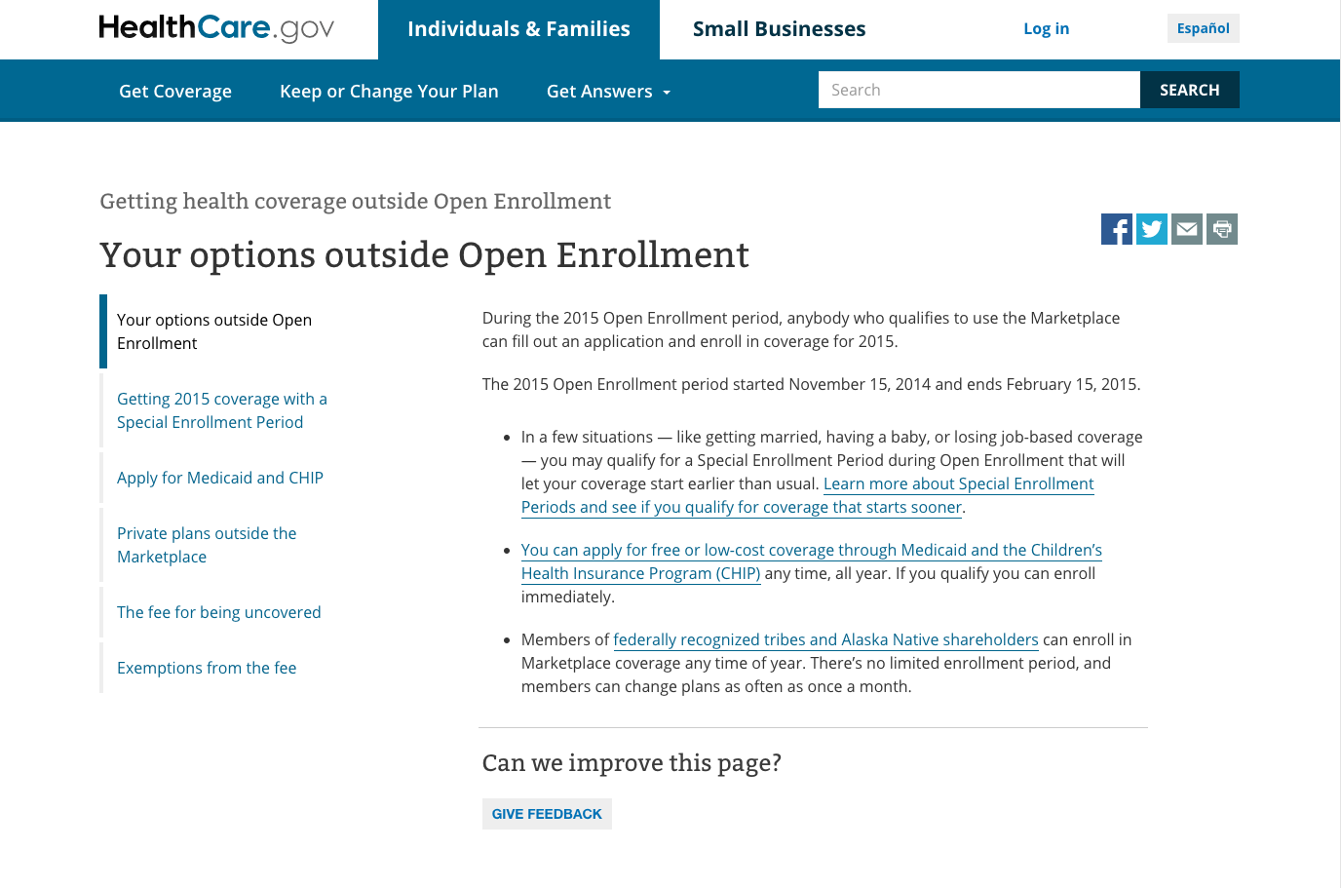
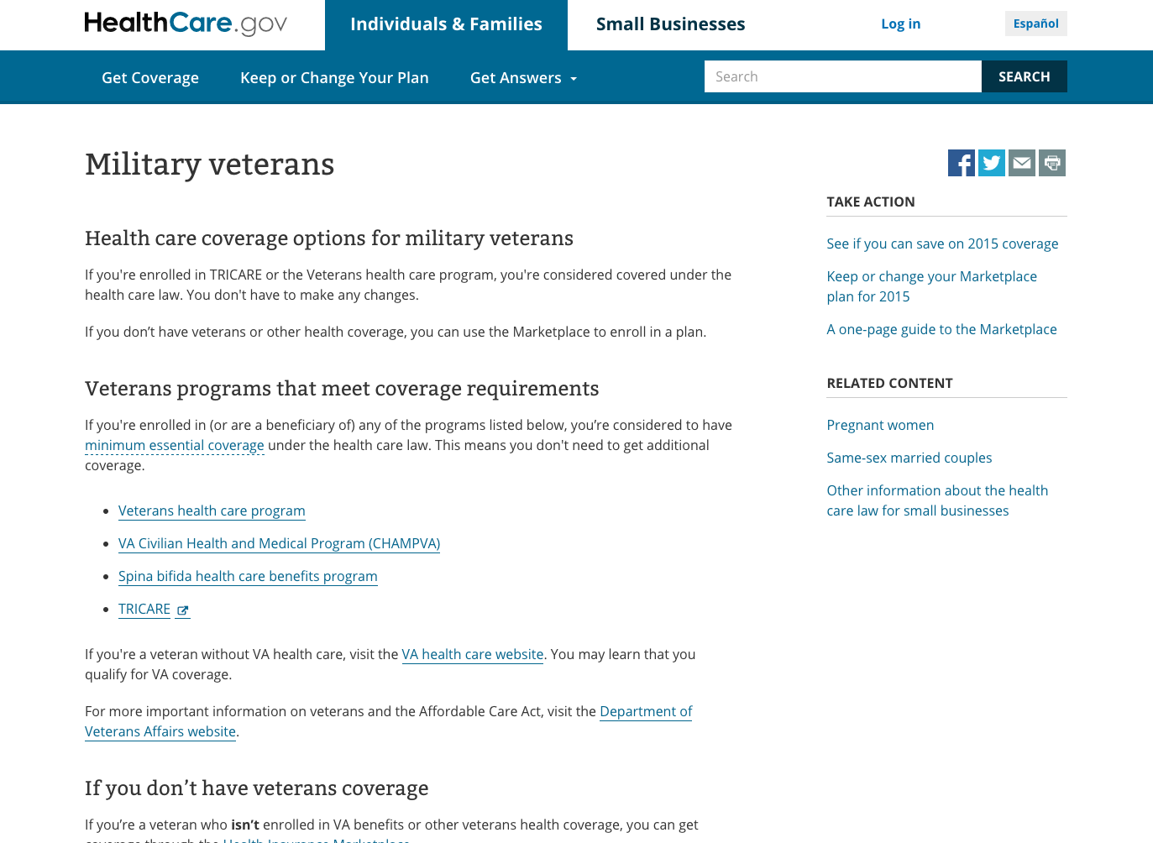
Explainer
Article

Slide 42
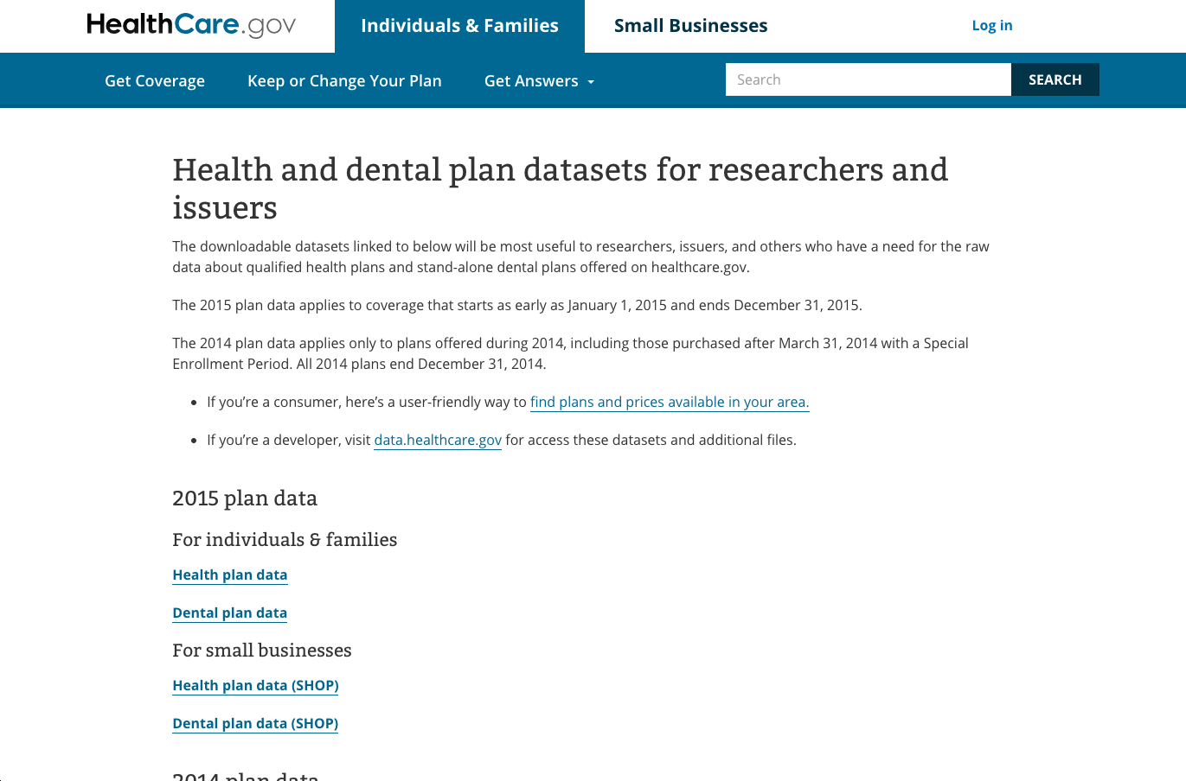
One Column

Slide 43
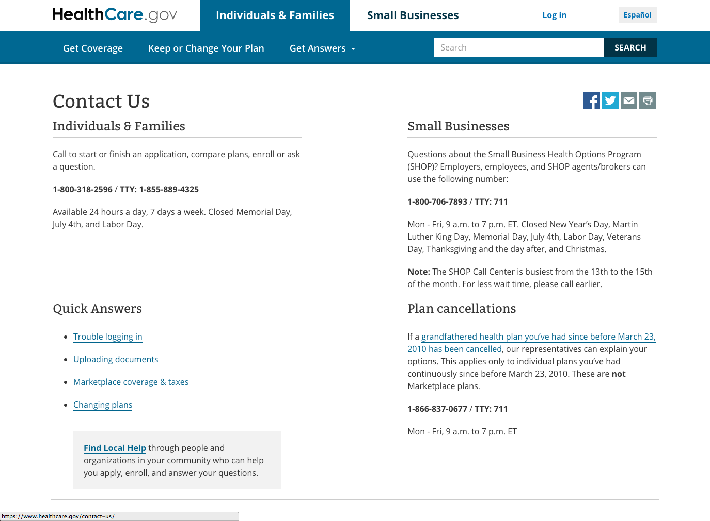
Two Column

Slide 44
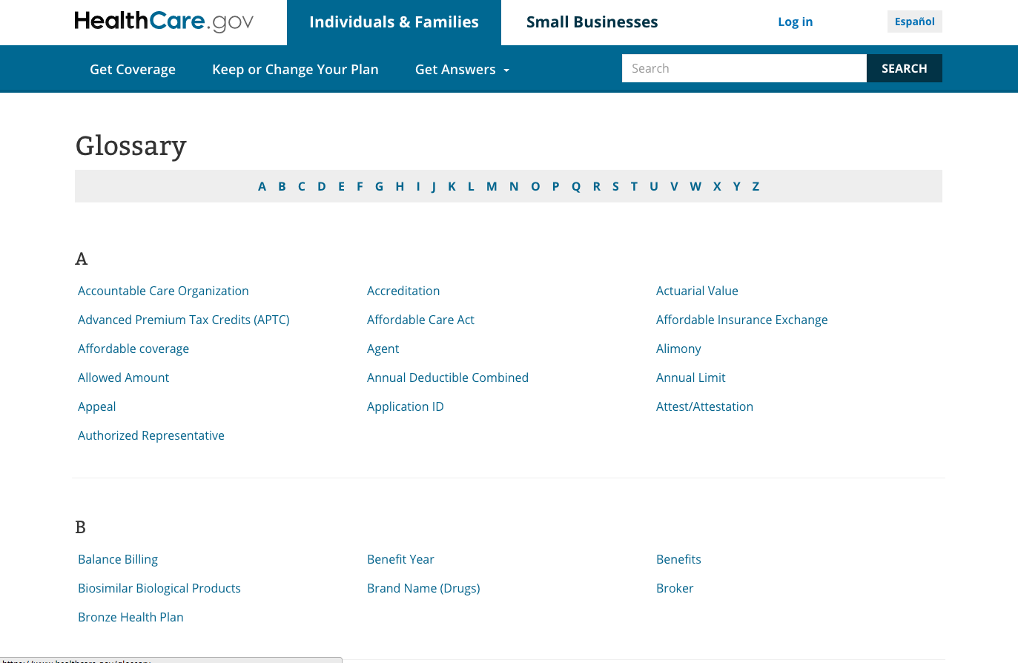
Glossary

Slide 45
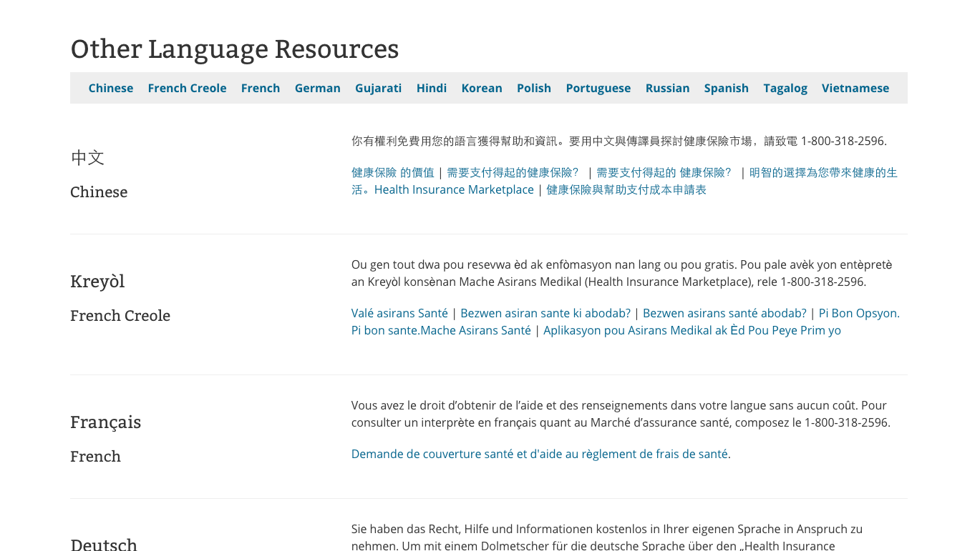
Language Resources

Slide 46
Language Resources

Slide 47
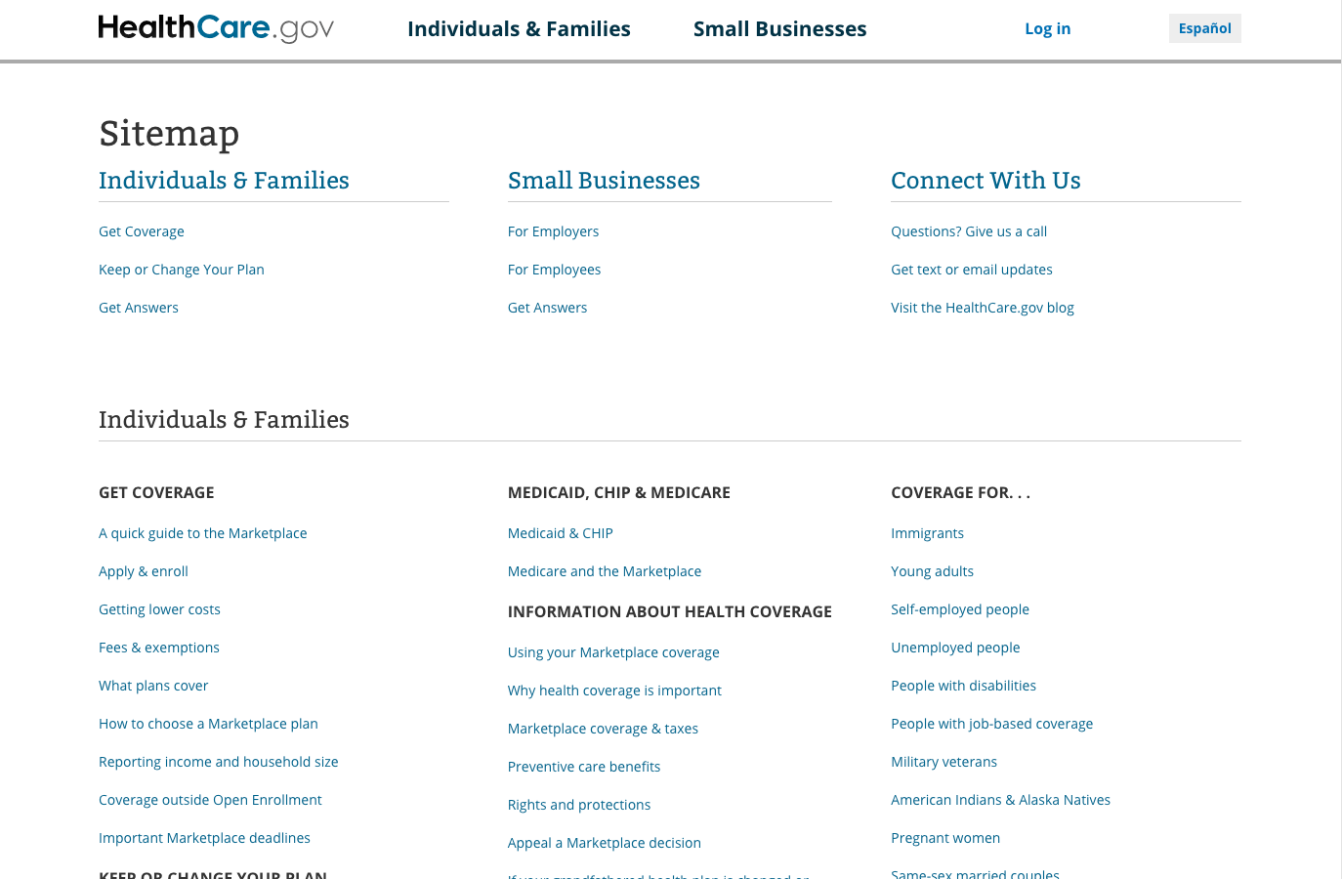
Sitemap

Slide 48
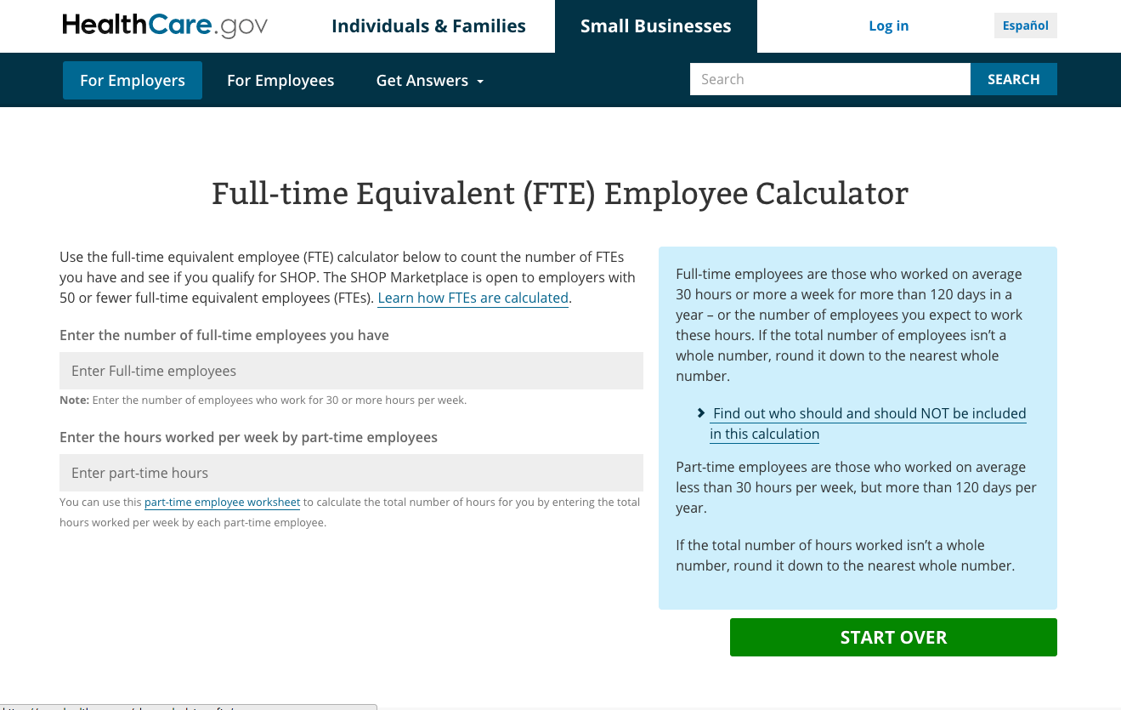
SHOP

Slide 49
SEP

Slide 50


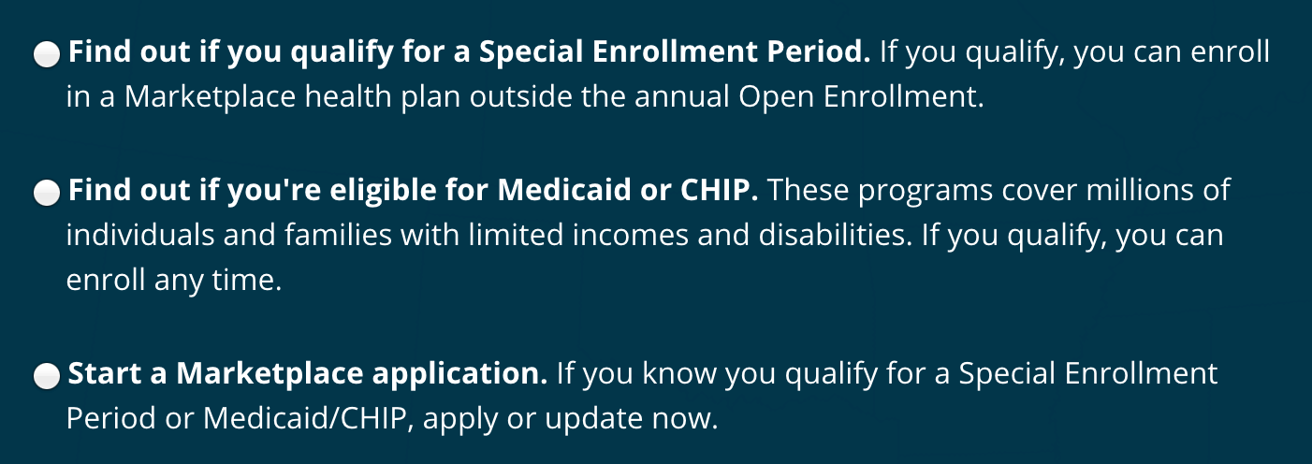
H1 – Bitter 36px font-weight 400 #FFF, letter-spacing normal, line-height 42px
Label – Open Sans 24px font-weight 500 #FFF
Selections – Open Sans 16px font-weight 400 #FFF, line-height 24px

Slide 51
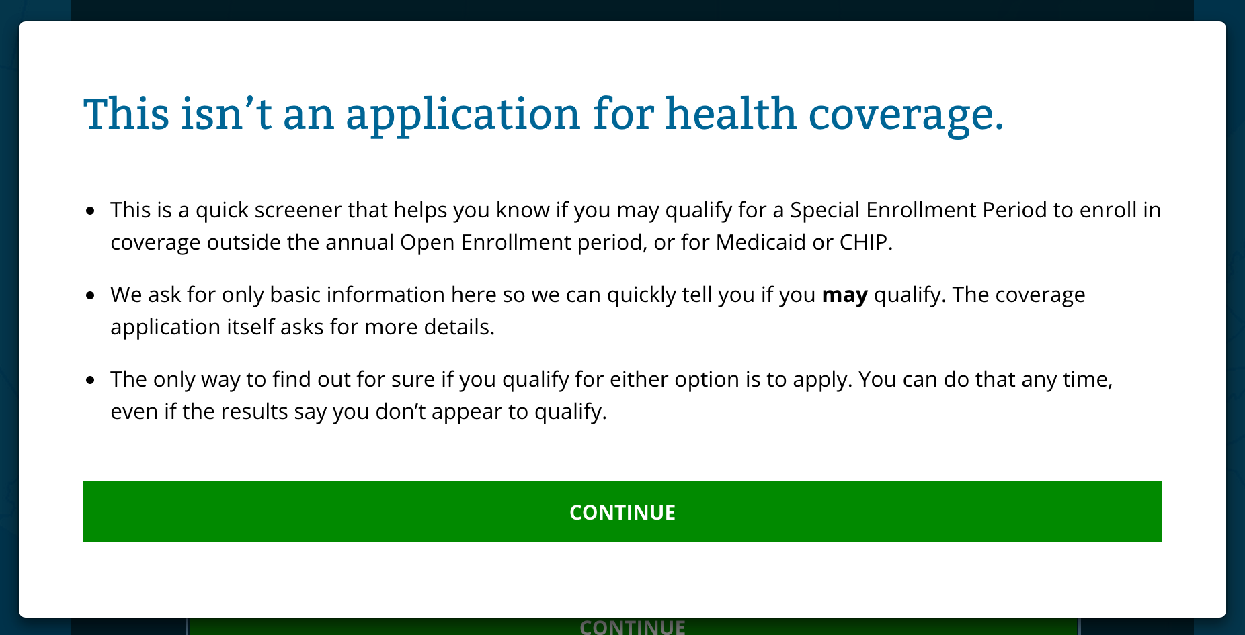
H1 – Bitter 32px font-weight 400 #006693, line-height 38px
List – Open Sans 16px #000, line-height 24px
Button – Open Sans 15px, font-weight 700 #FFF, Background #12890E / #138F0E

Slide 52
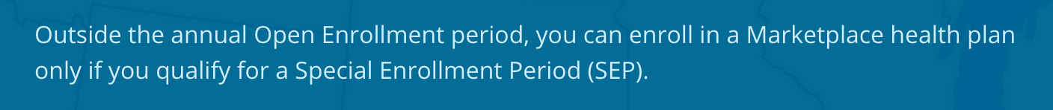
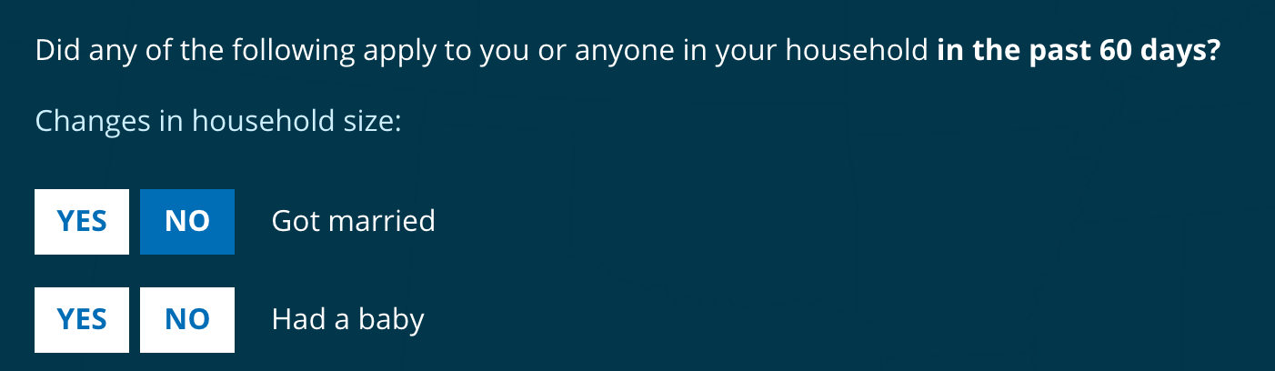
Questions intro – Open Sans 16px #CF3FFC, line-height 24px
List – Open Sans 16px font-weight 400 #FFF, line-height 24px
Button – Open Sans 16px, font-weight 700 #0E70B4/#FFF, Background #FFF/#0E70B4 / #12890E

Slide 53
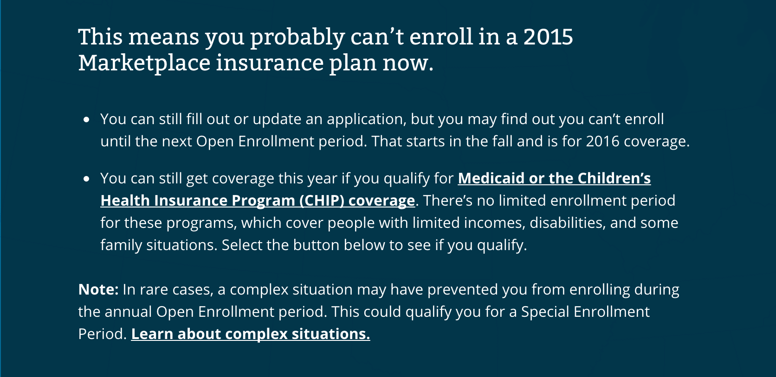
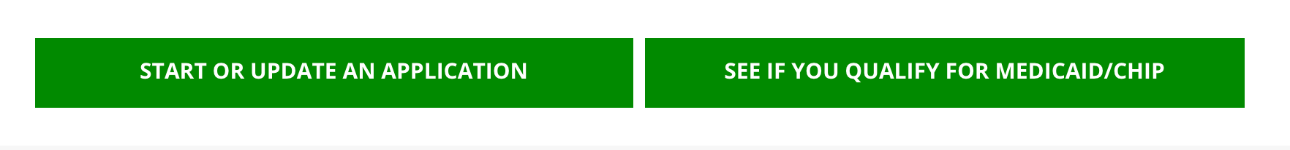
H3 – Bitter 24px #CF3FFC, line-height 28px
List – Open Sans 16px font-weight 400 #FFF, line-height 24px
Button – Open Sans 16px, font-weight 700 #FFF, Background #12890E/#138F0E

Slide 54
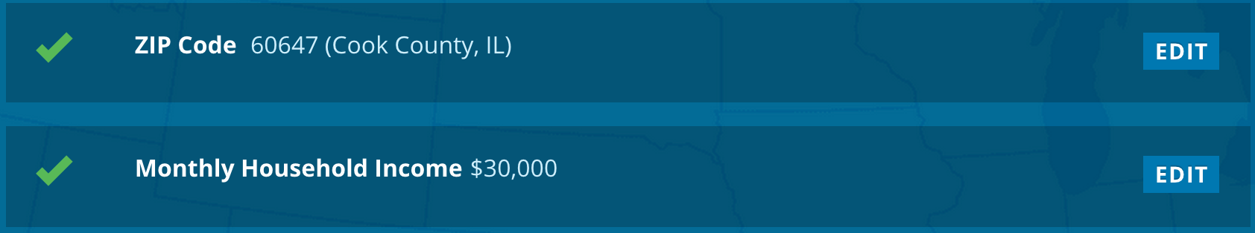
Completed steps – Glyphicon #5CB85C, Open Sans 16px Bold #FFF, #CFEFFC Button – Open Sans 16px font-weight 700 #FFF, Background #0279AF/#0E70B4

Slide 55
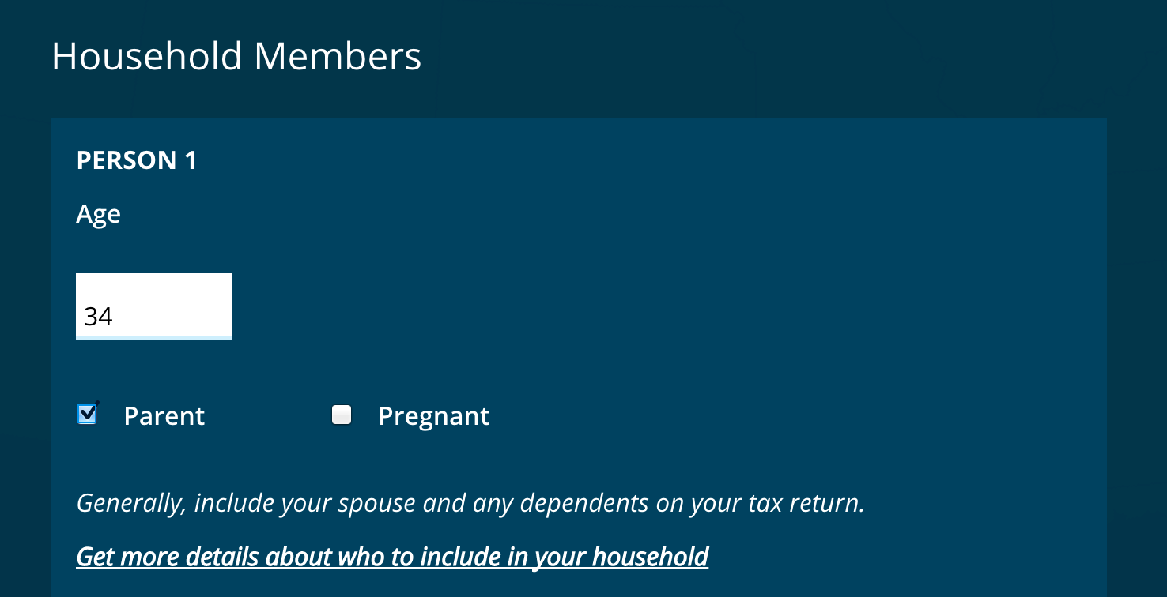
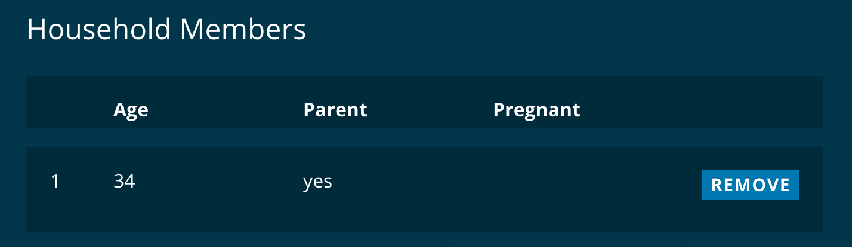
Household
H3 – Open Sans 24px #FFF Text – Open Sans 16px font-weight 700/600 #FFF Button – Open Sans 16px font-weight 700 #FFF, Button Color #0279AF/#0E70B4 Background #01435F
Results background rgba (0,0,0,.2)

Slide 56
Exemptions

Slide 57



H1 – Bitter 36px font-weight 400 #FFF, letter-spacing normal, line-height 42px
Text – Open Sans 16px/24px #FFF, line-height 24px

Slide 58

Button – Open Sans 16px font-weight 700 #FFF, Button #12890E/0F720C
Input text – Open Sans 18px #999/#555
Text – Open Sans 22/16px font-weight 400 #FFF / Selection background #0C4B66/#33687E

Slide 59


Calendar – Open Sans 16px font-weight 400 #FFF, Button #0C4B66/#33687E/#006595
Text – Open Sans 13px font-weight 400 #FFF / Background rgba(3,51,71,.5)

Slide 60

H2 – Open Sans 24px font-weight 600 #FFF / 16px #FFF
Button Open Sans 14px #FFF / Button color #0279AF/#0E70B4

Slide 61
PET

Slide 62


Start page
H2 class=“title”
size: 38px, weight: normal, font: Bitter, color: #fff, line-height: 37.5px;
Paragraph
size: 15px, weight: normal: color: #fff, line-height: normal
‘get started’ button
background-color: rgb(18, 137, 14), color: #fff; font size: 15px, font-weight: bold, width: 100%, line-height: 25px;

Slide 63

Application modal
Title: h2, h3, h4, h5, h6, class=“title”
Font: Bitter, size: 30px, color: rgb(0, 102, 147);
list items, paragraphs:
Font: Open Sans, color: rgb(51, 51, 51); size: 15px, weight: normal
Continue button
background-color: rgb(18, 137, 14), color: #fff; font size: 15px, font-weight: bold, width: 100%, line-height: 25px;

Slide 64
Application, current step (summary)
Checkmark (Step completed)
Bootstrap glyphicon, color: rgb(92, 184, 92),
X Icon (Step incomplete)
Bootstrap glyphicon, color: rgb(184, 92, 92);
Heading (h3)
Color: #fff, Font size: 16px, Font Weight: bold, font: Open Sans
Edit / Clear button
background-color: rgb(2, 121, 175), color: #fff, font-weight: bold
font-size: 13px; font: Open Sans

Slide 65

Application, current step

Slide 66
Application, current step (continued)
Heading (h3)
font-size: 24px, color: #fff, font: Open Sans, font weight: normal, Line-height: normal
Paragraph, lists
font-size: 15px, color: #fff, font: Open Sans, font weight: normal, Line-height: normal
Links (class=“help-text”)
font-size: 13px, color: #fff; font: Open Sans, font weight: normal;
background: white at 3% opacity, border-bottom-color: rgb(0, 101, 149);
Label
font-size: 16px, font-weight: 600, color: #ff, font: Open Sans, line-height: 24px
Continue button
background-color: rgb(18, 137, 14), color: #fff; font size: 15px, font-weight: bold, width: 100%, line-height: 25px;

Slide 67

Current step, feature box
Background color: #01435f
Heading (h4)
Font: Open Sans, color: #fff, Text-Transform: Uppercase, Font-size: 16px, Line-height: 24px, Font-weight: bold

Slide 68

Current step - summary table
Table rows
Background color (every other row): #052635
Table headings
Font: Open Sans, color: #fff, font-weight: bold, font-size: 15px

Slide 69

Sidebar widget
Background: rgba(3,63,90,0.35);
Heading (Paragraph, strong)
Font: Open Sans, color: #fff, Font-size: 12px Line-height: normal, Font-weight: bold

Slide 70
Progress meter
Completed: Background: #5cb85c
Incomplete: Background-color: rgb(217, 217, 217);

Slide 71
Message bar
Background: #17415f, color: #fff, font: Open Sans, font-size: 14px, font-weight: normal, line-height: 19px

Slide 72

Filter toggle switch
Font: Open Sans, font-size: 11px, font-weight: 600, line-height: normal, text-transform: uppercase
Selected:
background-color: rgb(96, 96, 96), color: #fff
Unselected:
background-color: rgb(220, 221, 222), color: rgb(20, 64, 96);

Slide 73
Sticky top bar
Background: rgba(255,255,255,.92), or White, 93% opacity
Filter items:
Background: #e8e9ea

Slide 74

Results cards
Background: #fff,
Box-shadow: 0 0 4px rgba(0,0,0,0.25);

Slide 75

Results card summary boxes
Heading (h3, small)
Font-size: 13px, text-transform: uppercase, font: Open Sans, color: rgba(0, 0, 0, 0.6), line-height: normal,
Heading (number)
Font-size: 32px, font: Open Sans, color: rgba(0, 0, 0, 0.6);
Paragraph
Font-size: 13px, line-height: normal, font: Open Sans, color: rgba(0, 0, 0, 0.6);

Slide 76

Results sidebar
Background: #e8e9ea
Headings: (h4) Font-size: 16px, Text transform: uppercase, font-weight: bold, Font: Open Sans, Line-height: normal
Links: Border-bottom: 1px solid #0c648c, color: #0c648c, font-size: 13px

Slide 77

Tool widget (light version)
Headings: (h4) Font-size: 16px, Text transform: uppercase, font-weight: bold, Font: Open Sans, Line-height: normal, color: rgb(51, 51, 51);
Links: color: #0c648c, font-size: 13px
List items: border-bottom: 4px solid rgba(0,0,0,0.05)

Slide 78

Tool widget (dark version)
Headings: (h4) Font-size: 16px, Text transform: uppercase, font-weight: bold, Font: Open Sans, Line-height: normal, color: #fff;
Links: color: #fff, font-size: 13px
List items: border-bottom: 4px solid rgba(255,255,255,0.1)

Slide 79
Tax Tools: Silver & Bronze

Slide 80
Start page
Links: Color: #fff, background-color: rgba(6, 51, 70, 0.34902), font-weight: bold, line-height: 18px, font-size: 15px

Slide 81

Block list radio button group
Color: #fff, background: rgba(255,255,255,0.05), font: Open Sans, font-weight: 600, font-size: 15px

Slide 82

Month picker
Color: #fff, font: Open Sans, font-weight: normal, font-size: 12px
Unselected: background: rgba(255,255,255,0.1)
Hover: background: rgba(255,255,255,0.2)
Selected: background: #006595

Slide 83

Information box
Background: #005f87, color: #fff, font-size: 13px

Slide 84

Alternating list

Slide 85
Alternating list (continued)
Background (odd rows): rgba(0,0,0,.1);005f87, color: #fff
Heading (h3)
Font: Bitter, color: #fff, font-size: 21px, line-height: 25px font-weight: normal,
Secondary content:
Font: Open Sans, color: #fff, font-size: 15px, line-height: normal, font-weight: normal
Secondary list:
Font: Open Sans, color: #fff, font-size: 13px, font-weight: normal, line-height: normal
Right column heading (h4)
Font: Open Sans, color: #fff, font-size: 13px, line-height: normal, text-transform: uppercase, font
Right column content
Font: Open Sans, color: #fff, font-size: 26px, font-weight: normal, line-height: normal

